Slide 1


Residential Rental in Africa
A framework for understanding and supporting the market
Kecia Rust
Policy Lab 1 on Policy & Legal Framework for Enabling Rental Housing
Wednesday, 16 September 2020 | 4:30 – 7:40 IST
CAHF’s work across Africa benefits from the support of:

Slide 2
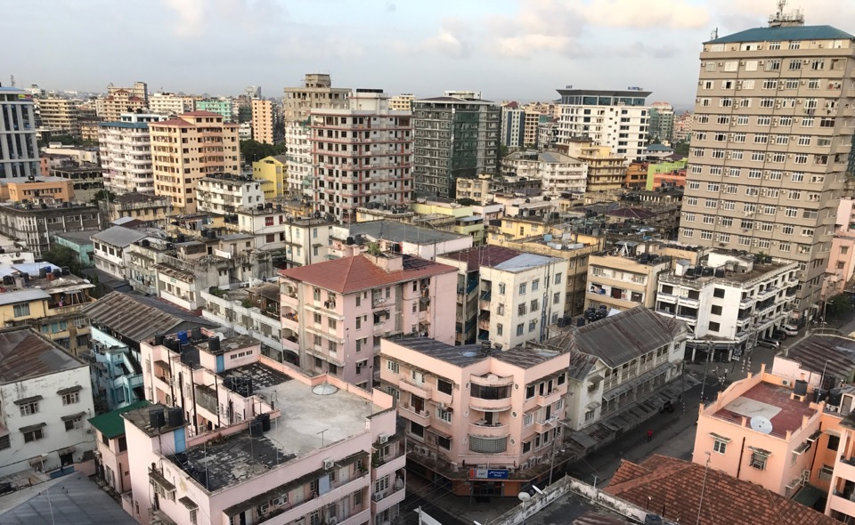
Dar es Salaam, Tanzania
Although scarcely recognised in policy, in many cities the majority rent. Who is delivering rental housing? Who manages it? How is it being maintained? At what market is it targeted?
Between 30%-of 50% of urban populations rent; sometimes more
Most are one room; many overcrowded
Access to services is poor with a minority having a tap indoors or a flush toilet in the property.
Average rental charges appear low: $18/month (Tanzania); $27/month (Uganda); $51 (Abidjan, Cote d’Ivoire)

Slide 3




Survey data shows that rental is a significant tenure form, and in some cities, the majority of residents are tenants. Household surveys reflect tenant perceptions, so likely also include informal rental.
COTE D’IVOIRE
SENEGAL
TANZANIA
UGANDA
TOTAL HOUSEHOLDS: 6 203 580
HOUSEHOLDS RENTING: 1 805 800
TOTAL HOUSEHOLDS: 1 590 692
HOUSEHOLDS RENTING: 319 100
TOTAL HOUSEHOLDS: 8 444 035
HOUSEHOLDS RENTING: 1 542 000
TOTAL HOUSEHOLDS: 6 756 913
HOUSEHOLDS RENTING: 790 350
(29%)
(20%)
(18%)
(12%)
54% of urban
78% of Abidjan
36% of urban
47% of Dakar
44% of urban
>50% of Dar es Salaam
29% of urban
46% of Kampala
ENV 2015
WB Listening to Senegal 2014
Household Budget Survey 2011/12
National Panel Survey 2013/14
Notes:
Some surveys also include data on landlords but not all of them

Slide 4
Survey data also shows that the housing conditions of tenants are very poor – durable structures but with poor access to services. How does this knowledge translate into policy?
COTE D’IVOIRE
SENEGAL
TANZANIA
UGANDA
TOTAL HOUSEHOLDS: 6 203 580
HOUSEHOLDS RENTING: 1 805 800
90% sheet metal roofs
81% hard (durable) walls
TOTAL HOUSEHOLDS: 1 590 692
HOUSEHOLDS RENTING: 319 100
66% concrete / cement roof
97% cement brick walls
TOTAL HOUSEHOLDS: 8 444 035
HOUSEHOLDS RENTING: 1 542 000
96% iron roof sheeting
64% cement brick walls
TOTAL HOUSEHOLDS: 6 756 913
HOUSEHOLDS RENTING: 790 350
96% iron roof sheeting
72% burnt/stabilized bricks
(29%)
(20%)
(18%)
(12%)
ENV 2015
WB Listening to Senegal 2014
Household Budget Survey 2011/12
National Panel Survey 2013/14
Notes:
Some surveys also include data on landlords but not all of them

Slide 5
To understand rental markets, we need to look at the whole value chain that supports their functioning
DEMAND
TENANTS
Demanders of rental, includes both current and potential tenants
LANDLORDS
Providers of rental in the market
MICRO
MACRO ENVIRONMENT & POPULATION
Macro economic conditions, population statistics as well as policy, regulation and legislation that affects the rental market
SUPPORT ORGANISATIONS
The organisations and institutions that help facilitate the development and operations of the rental market. Includes developers, financiers, credit bureaus and rental managers
MESO
MACRO

Slide 6
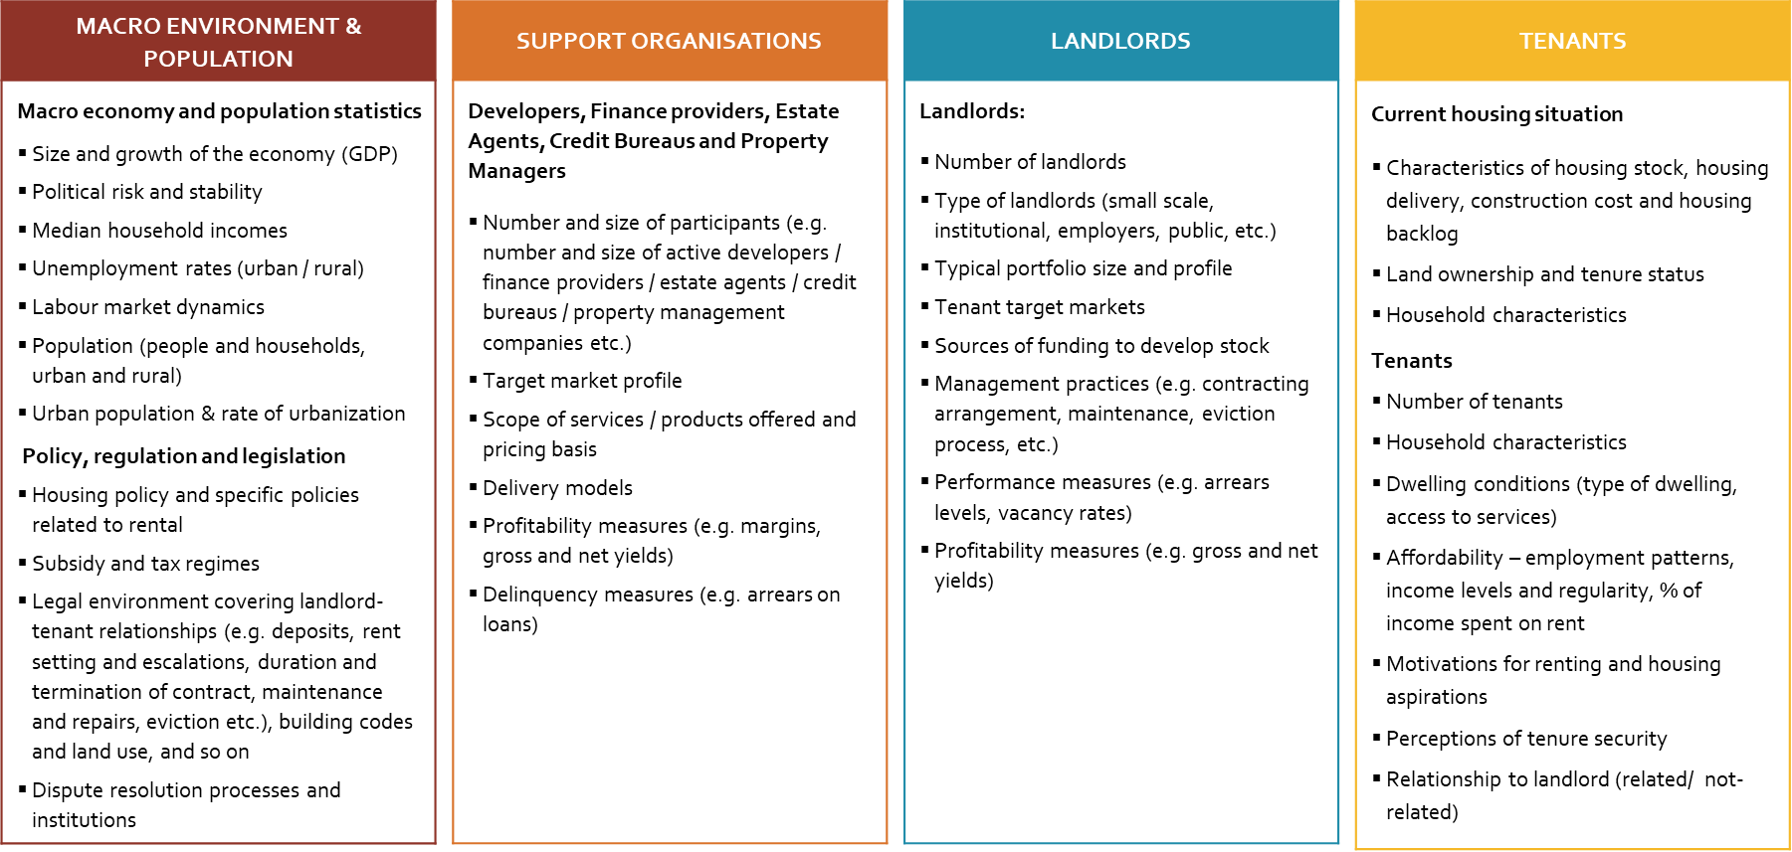
Each segment of the residential rental market offers opportunities for better understanding – this data needs to be actively collected and fed into the policy process

Slide 7
In some cases, pre-existing survey data provides useful information. Data on tenants and their housing conditions is relatively well covered in national household budget surveys. For example, in Tanzania:
Notes:
The MLSC 2014/15 survey provides a further indication of the income status of households that rent in Dar es Salaam. Enumerators were asked to rate the socio-economic status of the household being interviewed based on a six point scale: Destitute, Never have quite enough, Can manage to get by, Comfortable, Rich and Very Rich. The data indicates that a substantial percentage of tenants are poor and struggle to meet heir financial obligations – 27% of tenants are classified as ‘Never have quite enough’ and a further 47% ‘Can manage to get by’ (47%). There is however a sizeable segment of renter households that are more financially secure; just under a quarter are classified as comfortable (24%) and 2% as rich¹⁷.

Slide 8
What is less visible is supply side data: the type of rental available. CAHF has undertaken primary research in Tanzania to begin to understand the breadth
Expected categories:
Institutional landlords
Employer landlords
Government as a landlord
* But little data actually available
Types of housing being rented out in Dar es Salaam and Dodoma, Tanzania – percent of sample
Dominant categories, most of them invisible:
Household landlords
Sub-letting landlords (sometimes tenants themselves)
Backyard landlords
Small scale landlords
Resident / Absentee landlords
Cooperatives
Renting out:
Beds / Rooms
Backyard structures
New, refurbished, converted
Formal, informal, slum
Single / multi storey
Inner city / suburban
Source: Komu, F and S Ramparsad (forthcoming) Urban Rental Housing Markets in Tanzania: the case of Dar es Salaam and Dodoma. Prepared for CAHF.

Slide 9
What is less visible is supply side data: the type of rental available. We’ve found that different types of landlords serve different parts of the market – for example, in Tanzania:
Characteristic | Unit sizes | Types of units developed | Rent | Target groups | Tenant-landlord relationship | Area context
Private small-scale landlords | Sleeping room lettings range between 9m²and 16m² within detached house(s) with central corridor and shared toilet in the backyard, Two rooms-lettings, sleeping room between 9m² and 12m² and a living room of between 6m² and 10m², Split Dwelling Unit forming two lettings on either side of the unit, each between 12m² and 16m² | Detached units, Rooms with shared facilities, | Affordable to high rents | Low to Middle income | Informal to formal | Urban areas, peri-urban areas, Informal and formal housing areas
Private large-scale landlords | One-bedroom unit (Bed-sitter) of between 20m² and 36m², Two-bedroom units of between 39m²and 45m², Larger houses – three to four -bedrooms units of between 60m² and 82m² | Flats, Town Houses, Apartments, Villas | Mostly high rents | Middle to High income | Formal | Urban informal and formal areas
Employer based | One-bedroom unit (Bed-sitter) of between 25m² and 40m², Two-bedroom units of between 45m²and 50m², Larger houses – three to four -bedrooms units of between 60m² and 105m² | Flats, detached, semi-detached | Subsidized to rent-free | All income groups | Formal | Urban formal housing areas only. Government or semi-government land.
Public institutions | One-bedroom unit (Bed-sitter) of between 25m² and 40m², Two-bedroom units of between 45m²and 50m², Larger houses – three to four -bedrooms units of between 60m² and 105m² | Flats, detached, semi-detached, Townhouses, Apartments, Villas | Low rents (25% off market rents) | Middle to high income | Formal | Urban formal residential areas only.
Source: Komu, F and S Ramparsad (forthcoming) Urban Rental Housing Markets in Tanzania: the case of Dar es Salaam and Dodoma. Prepared for CAHF.

Slide 10
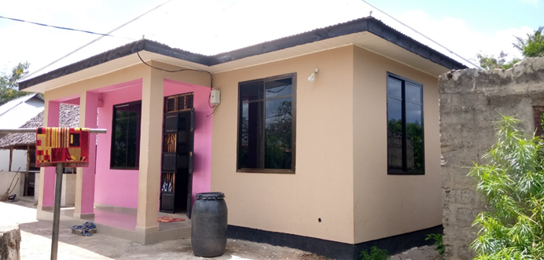
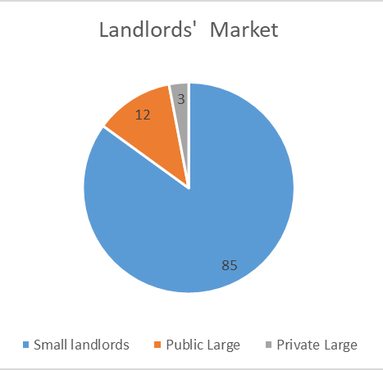
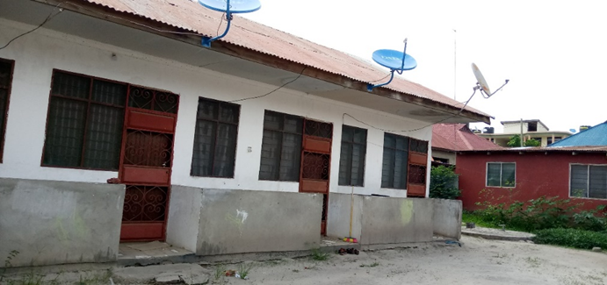
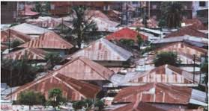
In fact, the rental housing market in Tanzania is dominated by small-scale landlords. Can this nascent market activity be leveraged in support of affordable housing? How does policy and the finance framework respond to this reality?
Who are small-scale landlords in Tanzania?
Individuals whose business is not primarily rental housing BUT have either converted part of their dwelling units into rental units. Others develop backyard units, or extensions on the same plot of land as a rental unit. The units are not always uniform in size, or design.
Individuals whose primary business is rental housing but with limited capital, may have up to five houses usually within a plot of land, and can also be referred to as small scale landlords.
Source: Komu, F and S Ramparsad (forthcoming) Urban Rental Housing Markets in Tanzania: the case of Dar es Salaam and Dodoma. Prepared for CAHF.

Slide 11
In South Africa, about a quarter ( 24.3% or 4 million) of households live in rented accommodation -
About 25% of formal dwellings are rented
About 40% of informal dwellings are rented

Slide 12
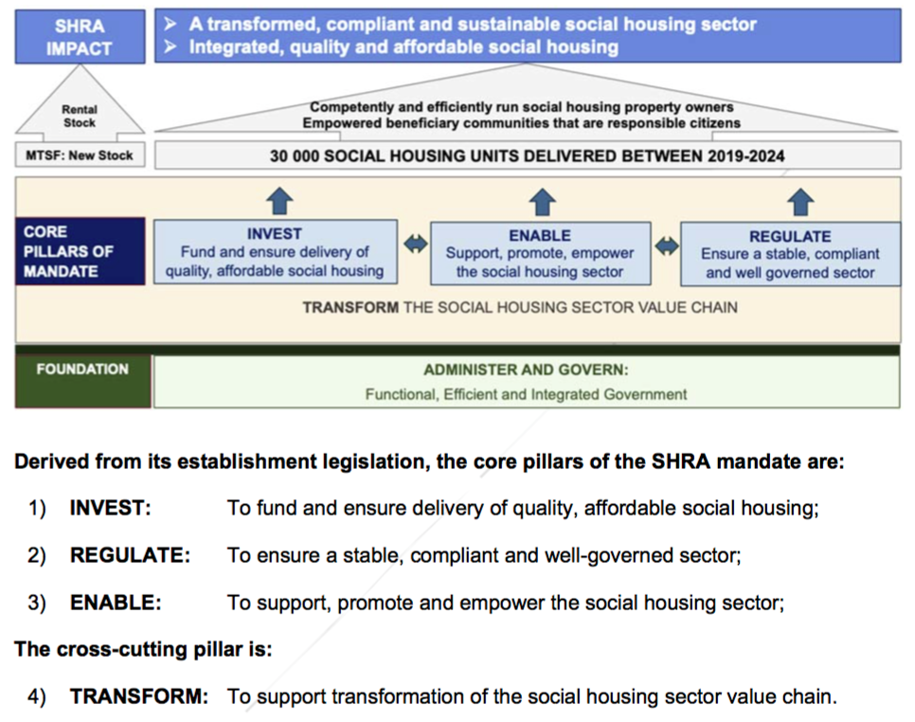
The South African government’s rental housing policy is focused on “social housing” – subsidised rental targeted at low-middle income earners
Currently, the social housing regulator has 39 407 social housing units in its portfolio.
The Medium Term Expenditure Framework promises the delivery of 30,000 units between 2019 – 2024, funded by a complex network of grants, equity and debt, all provided by public or publicly-supported institutions.
Of the 4 million households who rent, the social housing portfolio constitutes less than 1%. The promise of another 30,000 units would raise government’s programme to about 2% of the market.

Slide 13
Where is everyone else? A key driver of affordable rental housing has been TUHF Ltd.

Slide 14
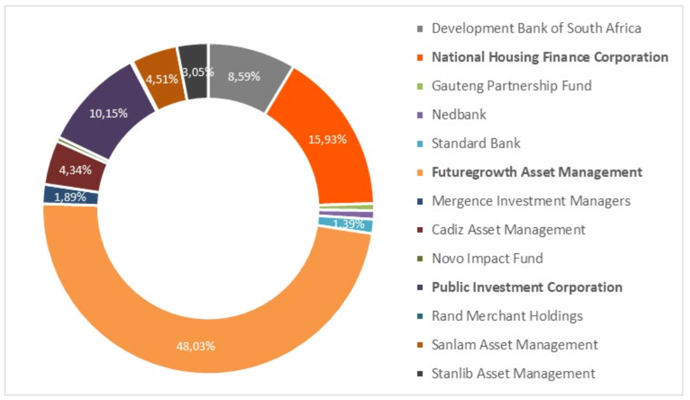
While they have received some state support, they have leveraged this to build a track record that can now crowd in private capital
TUHF’s funding structure (2005 - 2019)
Public company
Private company
NGO
Debt capital: TUHF lender analysis based on data from TUHF Integrated Annual Report 2018
“TUHF has developed from an organisation primarily reliant on bilateral debt finance to a company interested in exploring a diversity of funding types and sources.”
See Rebel Group (2019) Case Study 15 - Raising Capital to Regenerate Inner Cities: the case of TUHF Holdings (Pty) Ltd on http://housingfinanceafrica.org/documents/case-study-15-raising-capital-to-regenerate-inner-cities-the-case-of-tuhf-holdings-pty-limited/

Slide 15
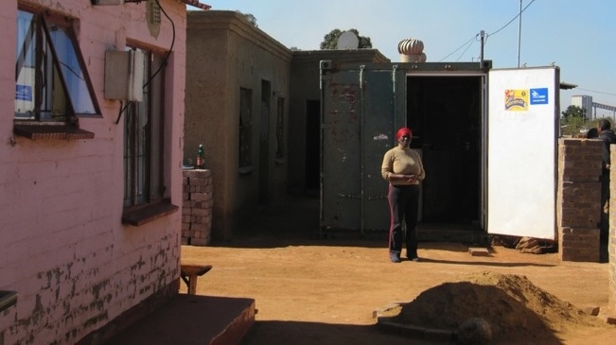
Johannesburg, South Africa
Income stream from the convenience store created cashflow to service construction of backyard rental units
Land rights created opportunity to locate a container refurbished as a convenience store, selling bread & milk
Original home, delivered by the state in 1994 as part of a national subsidy programme for qualifying beneficiaries
More housing is built incrementally than by any other means, and the small scale rental market creates entrepreneurial opportunities for otherwise unemployed households, while delivering affordable accommodation at a greater scale than traditional mechanisms. Home based enterprises create income streams that can further support housing investment.
It is estimated that 15% of all rental units in South Africa – 595 000 units – are provided by individuals in the backyards of their homes. This delivery sector is not supported by the social housing policy.

Slide 16
Policy & product opportunities exist along the value chain
Financing products:
Financing for small landlord buildings once complete as long as rental stream can cover mortgage instalments.
Equity support for new market entrants
Green construction methodologies with financing products
Limited bank supervision on compliance with regulations (average to poor buildings also financed)
Infrastructure
Varying provision.
Water and electricity typically provided, separate meters paid by tenants typical.
Sewage usually to soak pit which is exhausted regularly.
No parking
Construction
Piecemeal construction
Cheaper as purchase materials and hire labour with savings on VAT, contractor profit, no provision of amenities
Land Assembly
Private land, historically held or newly purchased, small parcels
Title / Tenure
Clean registered title
Offtake
Rental
Consumer protection issues
Maintenance & Management
Limited provision
Socio-economic infrastructure/ planning
Buildings closer to main road command higher rents
Enabling Framework:
Mechanisms to achieve quality, sustainability, durability and affordability, together
Explicit attention to small scale landlords / housing entrepreneurs
Urban infill infrastructure to respond to increased densities

Slide 17
Policy and product development in support of affordable rental housing markets must be evidence-based if it is to meet the actual need and leverage the very real opportunities. There are significant data gaps.
MACRO
Macro economy & population Size and growth of economy (GDP) Political risk and stability Median household incomes Unemployment rates Population (people and households, urban and rural) Urban population and rate of urbanization Policy, regulation and legislation Housing policy exists and includes specific policy related to rental Regulation and legislation specific to rental, including: deposits, rent setting and increases/duration and termination of contract/maintenance and repairs/eviction Existence of conflict resolution process Process to evict, average cost and average duration
MESO
Developers, Financers, Credit Bureaus and Managers Target markets Stock (units, vacancy rates, dwelling type, location, size etc.) Planned units Management practices (deposits, rent setting, duration & termination of contract, repairs & maintenance) Financing (developer finance) Gross and net yields Arrears Subsidies
MICRO
Landlords: Number of landlords Type pf landlords (small scale, institutional etc.) Target markets Characteristics of stock Financing Management practices (e.g. contracting arrangement, maintenance, eviction process, etc.) Arrears levels Subsidies
DEMAND
Current housing situation Housing stock and backlog Key elements in the housing value chain that have an impact on housing markets Land ownership and tenure status Type of dwellings and dwelling conditions Household characteristics Tenants Number of tenants and by type of rental (institutional, small-scale, etc.) HH characteristics and quality of life Dwelling conditions (type of dwelling, access to services) Affordability – employment levels, incomes and % of income spent on rent Motivations for renting
There is limited data on landlords available in the survey data
Analysis of classified can provide some insight into characteristics of dwellings and management practices
Company data and credit bureau data could assist with arrears statuses
Survey/ census data provides a useful overview of tenure status, dwelling conditions and household characteristics
Limited data on housing stock and backlog, as well as the key elements in the housing value chain that impact on housing
Easy to find and freely available
Secondary data does not provide much insight into the meso layer
Requires supply side information
Analysis of rental classifieds can provide some sense of deposits and rent prices
Data held by companies can assist with stock indicators, planned units and management practices
Survey/ census data can be used to size the market and understand dwelling conditions and household characteristics
However, limited detail on the type of rental (some indication of public/ private), affordability, and no indicators on motivation for renting
Country specific, highly nuanced and difficult to determine levels of enforcement where laws exist
DATA GAPS EXIST
DATA GAPS EXIST
DATA GAPS EXIST

Slide 18





Thank you!
Kecia Rust
kecia@housingfinanceafrica.org
www.housingfinanceafrica.org
+2783 785 4964
https://www.facebook.com/HousingFinanceAfrica?ref=hl
Twitter @CAHF_Africa
Twitter @AUHF_Housing
CAHF is the Secretariat to the:
CAHF’s work is supported by

Slide 19
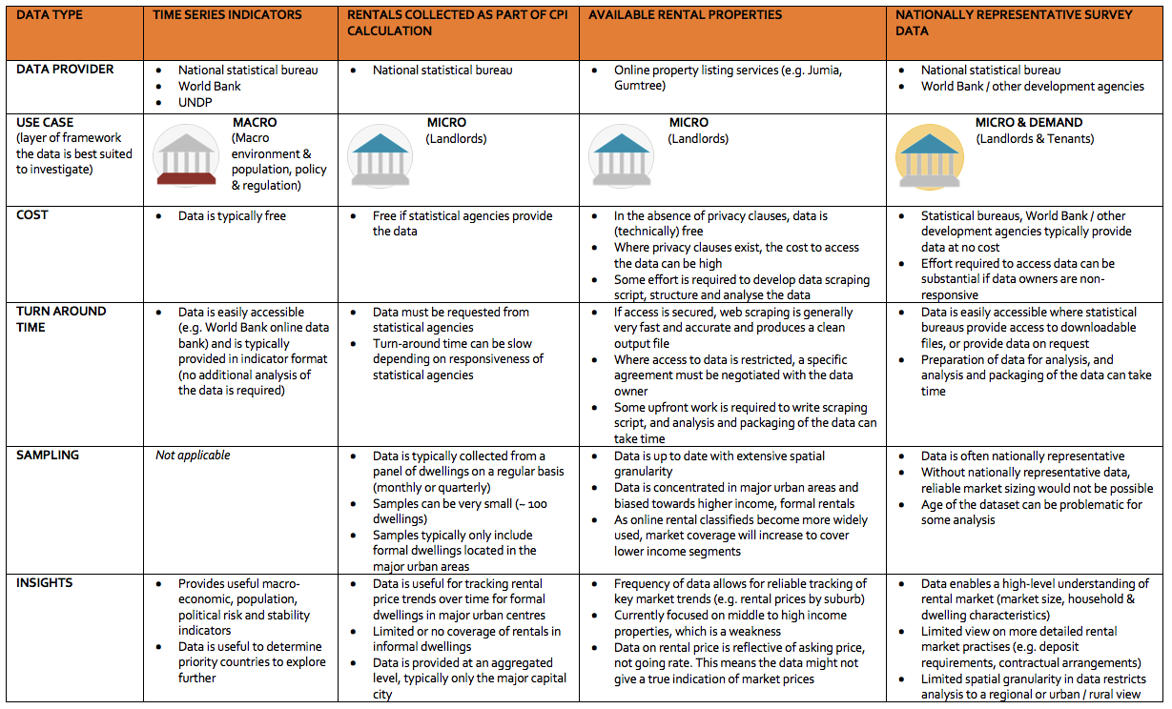
Assessment of secondary data sources

Slide 20

Many people believe there is limited survey data available north of South Africa. However, relatively recent census data, and nationally representative surveys exist. But not all of it is easily accessible, and much of it is old.
 | Country | Survey name | Last survey year | Previous survey years | Sample size | Availability
 | Angola | Census | 2014 | - | 2 478 705 individuals | ✗
 |  | Basic Welfare Indicators Suvey | 2011 | - | 8 640 households | ✗
 | Cote d’Ivoire | Census | 2014 | 1988, 1998 | - | ✗
 |  | Enquete Niveau De Vie Des Menages (Env) | 2015 | 1993-1995, 1998, 2002, 2008, 2011 | 12 900 Households | ✓
 | Senegal | WB Listening to Senegal | 2016 | 2014 | 1 500 Households | ✓
 |  | Census | 2013 | - | - | ✗
 |  | Monographic survey on real estate services in Dakar | 2010 | - | - | ✗
 | Tanzania | Census | 2012 | 1967, 1978, 1988, 2002 | 4 498 022 | ✗
 |  | National Panel Survey | 2012/13 | 2008/09, 2010/11 | 3 265 Households | ✗
 |  | WB Measuring Living Standards Survey | 2014/15 | - | 2 083 Households | ✓
 |  | Household Budget Survey | 2011/2012 | 2000/01 | 10 400 Households | ✓
 | Uganda | Census | 2014 | 1980, 1991, 2002 | - | ✗
 |  | National Household Survey | 2016/17 | 1999/2000, 2002/03, 2005/06, 2009/10, 2012/13 | 6 896 Households | ✗
 |  | National Panel Survey | 2013/14 | 2009/10, 2010/11, 2011/12 | 3 119 Households | ✓

