Slide 1
Rental Housing Scheme
in Mumbai Metropolitan Region,
Maharashtra

Slide 2
.
About Rental Housing in MMR, Maharashtra
MMRDA initiated the idea of Rental Housing Scheme on Public Private Partnership.
Considered as a “Vital Public Purpose Project” and also know as a “Slum Prevention Programme”.
GoM has appointed MMRDA as the Project Implementation Agency for the Rental Housing Scheme.
Objective :
To make available a self-contained dwelling unit of 160 sq.ft. carpet area on leave and license basis in the Mumbai Metropolitan Region within the financial reach of Economically Weaker Section (EWS) and Low Income Group (LIG) i.e at an affordable rent of Rs. 800 to 1500 per month.

Slide 3
About Rental Housing in MMR, Maharashtra
Eligibility Criteria:
The allottee under the project shall have employment/self employed within MMR with a minimum family income of Rs. 5000/- per month.
The allottee and his family member shall not own any house in Mumbai Metropolitan Region.
The allottee should be Domicile of Maharashtra.
The allotment shall be made in the joint name of spouse, if married.
GoM has formulated GRs for ULB areas and Non ULB areas (which are designated as U1 and U2 in the Regional Plan of MMR) for implementing Rental Housing Schemes in MMR.
Applicable GRs:

Slide 4
Options for development
The Rental Housing scheme grants additional FSI or TDR as incentives to the owner / developer with the following 4 options:
SI. No | Area | Model | Total FSI | FSI for Rental Housing | FSI for Developer
1 | ULB and SPA areas where development is to be undertaken by land-owner or an agency approved by MMRDA | Model- 1 | 3.0 | 3.00 | Land TDR equivalent to plot area + Construction TDR of 1.33 X 3.00 FSI
2 | ULB and SPA areas where development is to be undertaken by land-owner or an agency approved by MMRDA | Model-2 | 4.0 | 1.00 | 3.00
3 | Non ULB areas designated as Urbanisable Zone-1 (U1) and Urbanisable Zone-2 (U2) in the Regional Plan within MMR | Model-2 | 4.0 | 1.00 | 3.00
4 | Construction of Rental Housing on any land vested with MMRDA in MMR | Model-3 | 4.0 | 3.00 | 1.00 free-sale/ commercial (to be developed by MMRDA)
All the Proposals received under Model
2 & 3 only
Rental Component
25% Land with Rental Housing Units of 1 FSI of net plot area.
To be handed over to MMRDA Free of cost
Net Plot Area (After deduction of DP/RP road, other reservations etc) is considered for Calculation of 4 FSI
75% Land Retainable with Developer for Free sale in Open Market with 3 FSI of net plot area.
Free Sale Component

Slide 5
Rental Housing Scheme, MMR – 2008
4 FSI : 1 for Rental and 3 for Free Sale
Min. plot size : 500, 1000 and 10,000 Sq. m. in Greater Mumbai, other ULBs / SPA areas & Non ULB areas (U1-U2) areas respectively
MMRDA to get 25% of land and rental tenements thereon free-of-cost
160 sqft and as subsequently decided by GoM 320 sqft carpet area tenements required to be constructed.
Upto 15% of built up area permitted for commercial use
160 Sq.ft tenement
Infrastructure Charges
Charges levied @ Rs. 1000, 500 and 250 per Sq. m. - over and above normal permissible FSI - Mumbai, ULBs/SPA areas and non ULB areas respectively
Out of the total infrastructure charges collected in ULB, 90% of the same is transferred to concerned ULBs for provision of infrastructure.
320 Sq.ft tenement

Slide 6
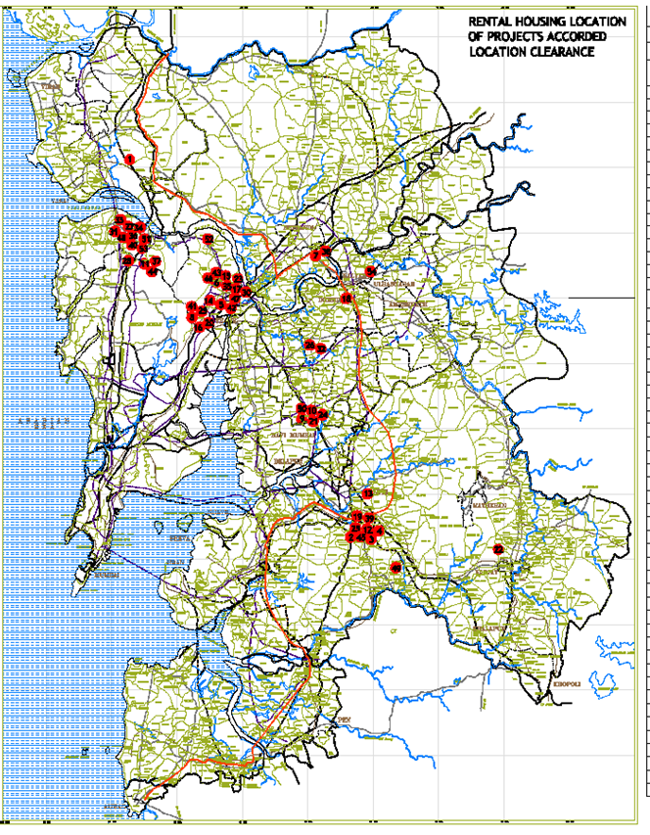
Status of Rental Housing Schemes
Location Clearance granted to 47 proposals at various locations in MMR which will generate about total 64190 tenements and 867 shops of both 160/320 sq.ft carpet area.
Most of the schemes are located in 4 major clusters:
Thane (15), Mira Bhainder (13), Panvel (5), Palaspe (6)

Slide 7
Allotment switch – from Rental to Transit / Permanent allotment
While the Rental Housing Scheme were being implemented, there were demand for houses from various quarters.
PAPs of ULBs and MMRDA
Textile Mill workers
Police Department
Class III and IV employees of other Govt. and MMRDA
Other Central and State Housing Schemes
In light of above, GoM and MMRDA have formulated a policy for allotment of tenements from ULBs and non ULB areas of MMR for the same

Slide 8
Allotment Policy in ULBs & Non ULB areas
Present policy for allotment of tenements as per various GRs and GoM letters
ULBs - 50% tenements for transit accommodation for PAPs
Non ULB areas - 50% tenements for mill workers
Policy for remaining 50% tenements from both ULBs and Non ULB areas
SI. No | Details | % calculated on remaining 50% of tenements
1 | MMRDA’s Class III and IV employees | 3%
2 | PAPs of MMRDA / ULBs as per the priority that may be decided by MMRDA | 97%
Allotment policy of shops
- shall be utilized for MMRDA’s PAPs
- to ULBs on demand as per rates of ASR
- Balance shops to be sold in market by tender

Slide 9
Procedure followed for granting approvals / implementing RHS
MMRDA grants Location Clearance and approves schematic layout of Rental Component and then concerned Planning Authorities issues the Commencement Certificate (CC)/Occupation Certificate (OC) based on the NOC for CC and OC granted by MMRDA .
MMRDA suggests building profile, no. of buildings, max. floors in each building etc. for Rental component buildings and approves the Layout considering maximum open spaces in the layout and light and ventilation as well for RH Buildings.
MMRDA has finalised the specifications along with Make for finishing items such as Electrical, Sanitary Fitting, Building Material, Fixtures etc. and also grants approvals for Sample flat, internal and external Colour Scheme to get the best quality Rental tenements.
Engineering Division of MMRDA checks / verify the construction quality and insists for approvals for structural stability institutions like from IIT, Bombay and VJTI.
Various site visits are carried out by Rental Housing and Engineering Division to check the quality and completion of construction before issuance of any approval.

Slide 10
Procedure followed for granting approvals / implementing RHS
CC and OC for free sale is granted in proportion to construction and completion of Rental Component and therefore Rental Component is always in advance stage than Free sale component.
Stages for grant of NOC for CC
Sr. No. | Stages of Release of FSI | Rental Component | Free Sale Component | Free sale component
 |  | (All Areas) | In ULBs | In U1 U2
1 | On Grant of BP/CC up to plinth by ULB/planning Authority for entire project | 1.00 | 1.00 | 0.25
2 | On completion of 50% plinth of Rental component | - | 0.50 | 0.50
3 | On Completion of 25% BUA of Rental Component | - | - | 0.50
4 | On Completion of 50% BUA of Rental Component | - | 0.50 | 0.25
5 | On Completion of 75% BUA of Rental Component |  | 0.35 | 0.50
6 | On Completion of 100% BUA of Rental Component | - | 0.40 | 0.75
7 | On handing over of “25% land & completed Rental component buildings” with occupancy certificate & completion certificate | - | 0.25 | 0.25
NOC for OC is granted in 1:3 proportion (Rental : Free Sale)

Slide 11
Benefits of Rental Housing Scheme
Self sustainable project - no funding / investment from Govt.
Free housing stock of tenement size of 160 / 320 Sq. ft carpet area in MMR.
Free buildable amenities such as balwadies, welfare centres, managers cabins shops etc. to meet the community requirements.
Housing for Millworkers at 6.00 lacs per 320 Sq. ft tenement : generate revenue for MMRDA
Housing for Class III and Class IV employees of State Govt, MMRDA and Police, generation of revenue.
Land Bank (i.e 25% of Rental component land from the each scheme) with ready to occupy tenements and shops.
Only for in-situ rehabilitation of the people, the tenements being made available from the Rental Housing Schemes are now being used to fulfil the demand of houses for PAPs and also housing demand for textile Mill workers, Police Department, transit accommodation for ULBs, PMAY and Other Central and State Housing Schemes etc.

Slide 12
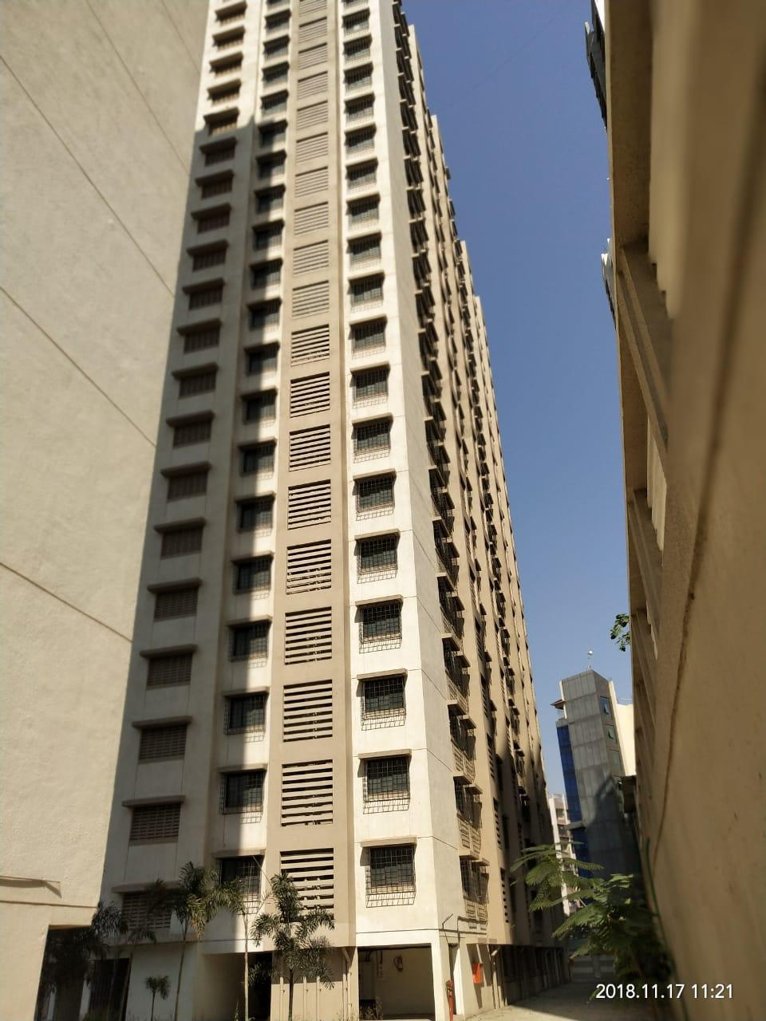
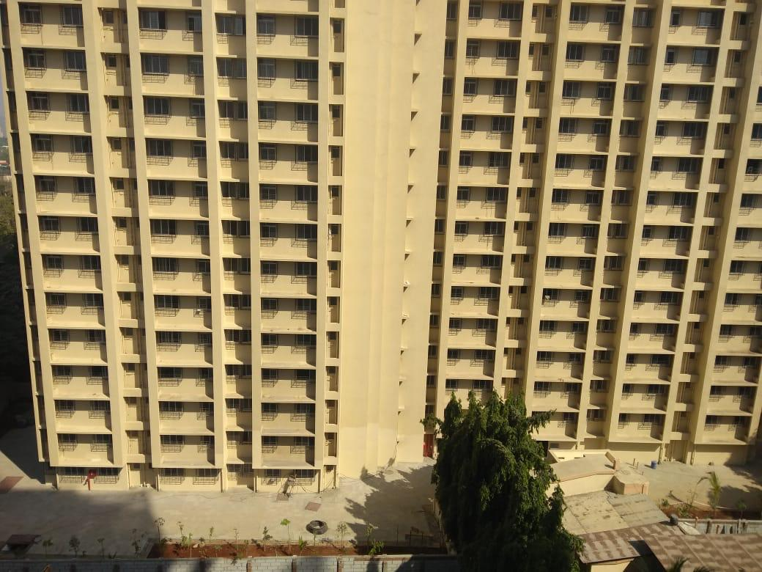
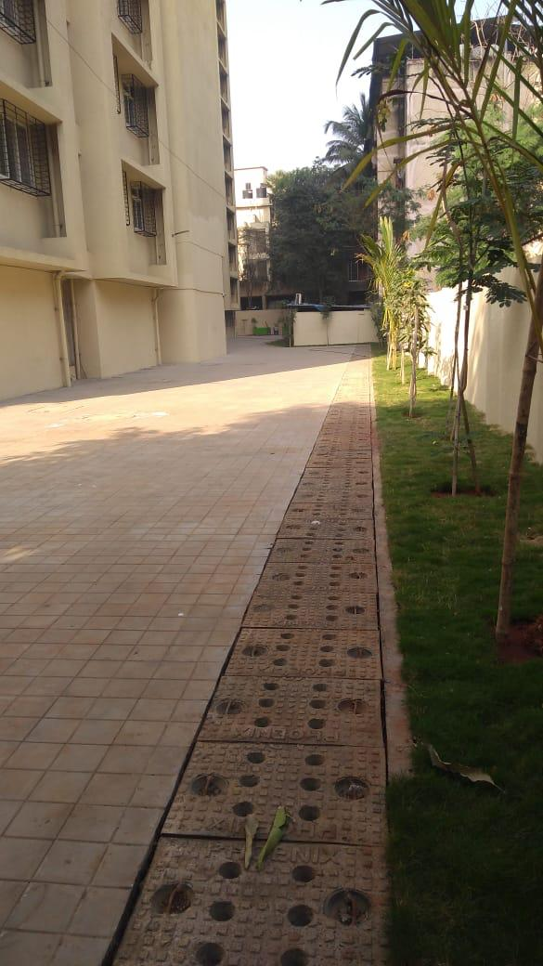
Existing Rental Housing projects
Switch From Rental to Affordable Housing
August, 2014, the Government replaced the ‘Rental Housing Scheme’ with the ‘Affordable Housing Scheme’ in the Municipal with the intension of providing houses to general people.
The Affordable Housing Scheme is being implemented by the respective ULBs.
Rental Housing Scheme is discontinued in the non-municipal areas of MMR.

Slide 13
Thank you

